Slide 1
Marketing Analytics
Session 5
Scoring (basic)

Slide 2
Agenda
Assignment #1
Feedback
Presentation
Predictive modeling
Introduction
Calibration
Logistic regression (logit)
Linear regression
Scoring

Slide 3
ASSIGNMENT #1
Feedback

Slide 4
Major comments
Do not present data in a misleading way
Do not assume you know…
Be clear, be consistent
Keep it simple
Do not overuse statistical models

Slide 5

Know tho industry ! Understand tho data !
It is extremely easy to present misleading information
It can be on purpose (liar)
It can be by accident (misguided)
The only solution:
Know tho industry !
Understand tho data !
Question everything
Business domain expertise is essential

Slide 6
Know tho industry ! Understand tho data !

Slide 7
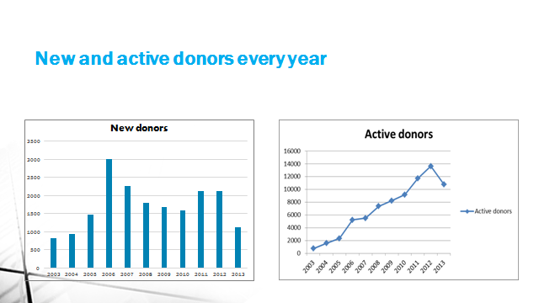
Know tho industry ! Understand tho data !

Slide 8
Know tho industry ! Understand tho data !

Slide 9
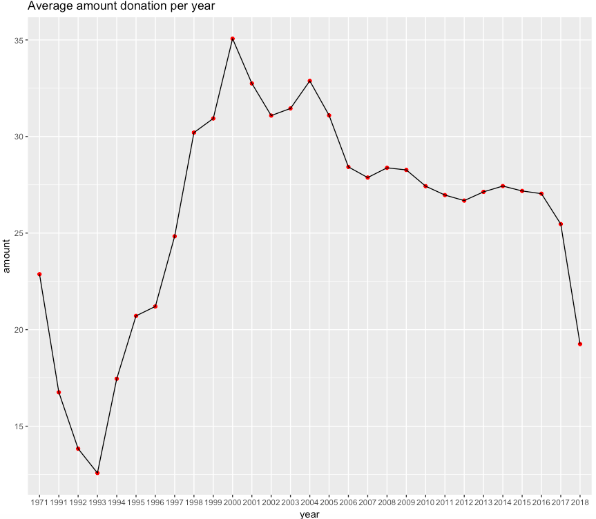
Know tho industry ! Understand tho data !

Slide 10
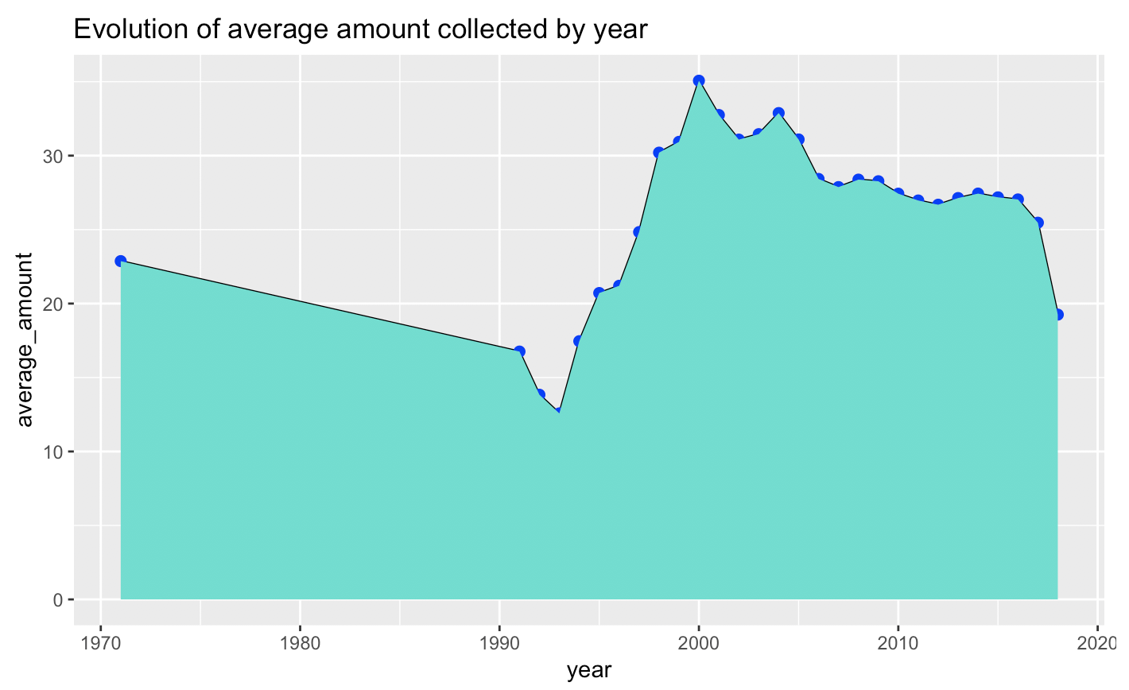
Know tho industry ! Understand tho data !

Slide 11
Accidentally misleading…

Slide 12
Accidentally misleading…

Slide 13
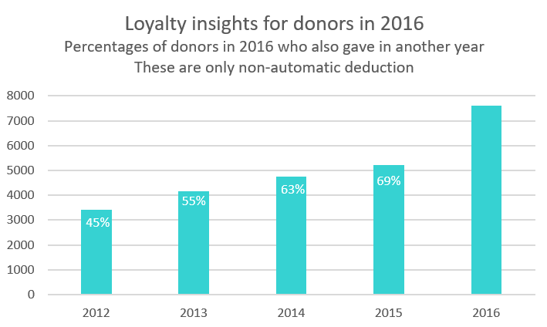
Accidentally misleading

Slide 14
Know tho industry ! Understand tho data !

Slide 15
Example (same scale)

Slide 16
Example (different scales)

Slide 17
Don’t assume you know…
There is a fine line between « guessing » and « pretending you know »
Don’t cross it !
If not sure, better present them as question marks…

Slide 18
Don’t assume you know…

Slide 19

Be übber-clear, be consistent
What are you showing?
Axis?
Scale? (people, acts, money)
Time period?
In what order?
We read from top to bottom, left to right
How you have reached these figures
Have you excluded data points? Why?
What methods you have used
Why that method?
Why 5 segments?

Slide 20
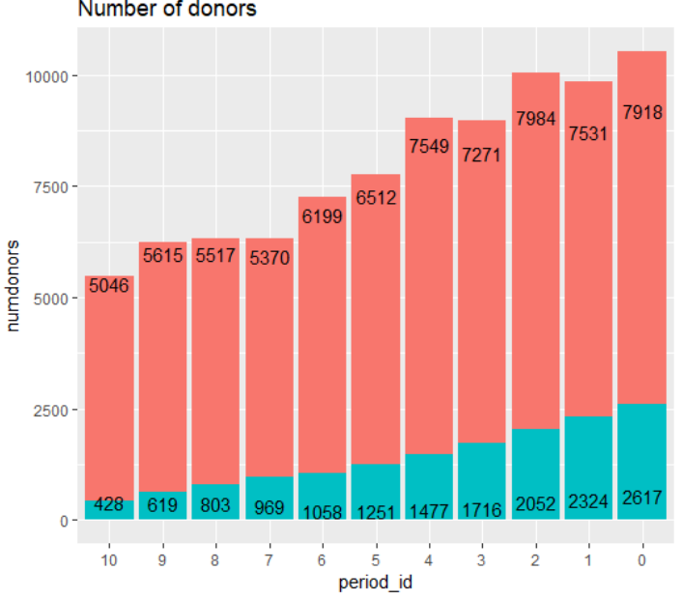
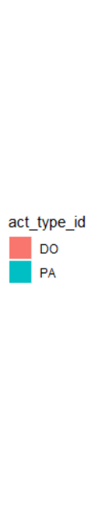
Technical jargon? Double counting?

Slide 21
Technical terms and scientific notation

Slide 22
Be übber-clear, be consistent

Slide 23
Be übber-clear, be consistent

Slide 24
Be übber-clear, be consistent

Slide 25
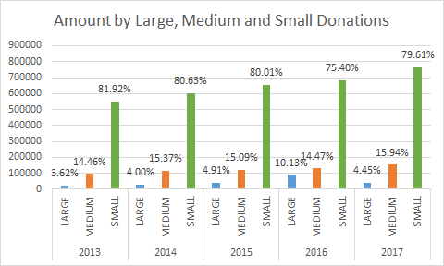
Be übber-clear, be consistent

Slide 26
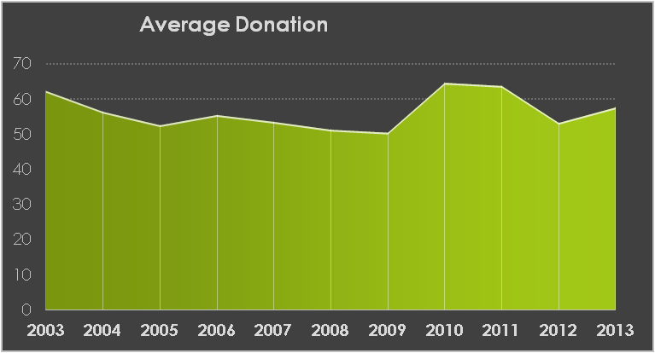
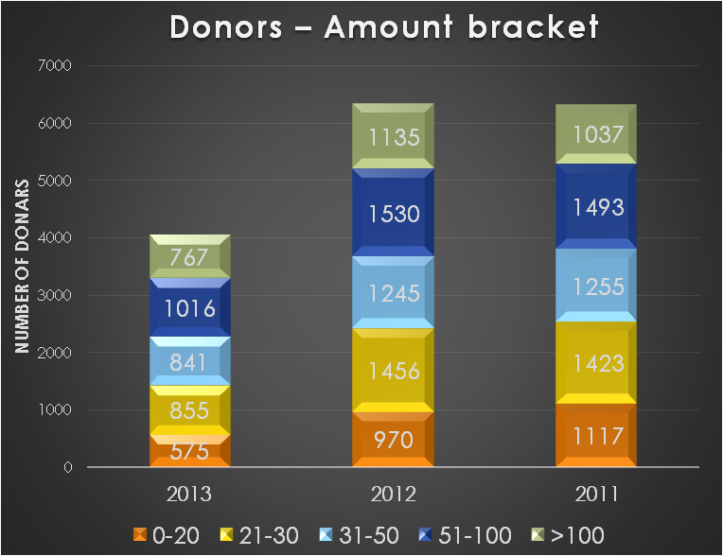
Be übber-clear, be consistent

Slide 27
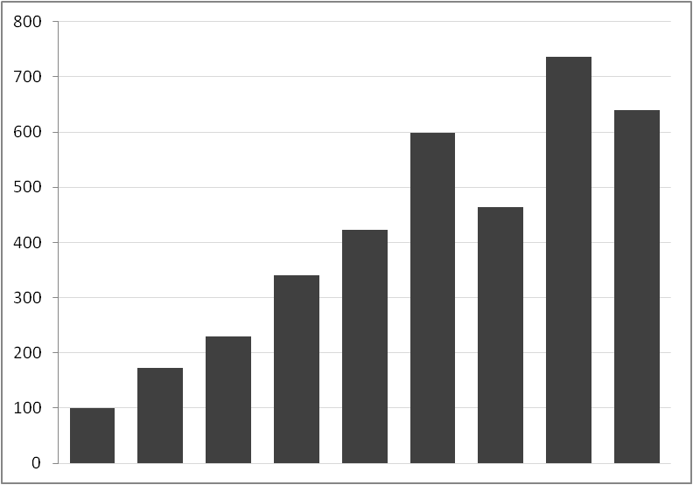
KISS

Slide 28
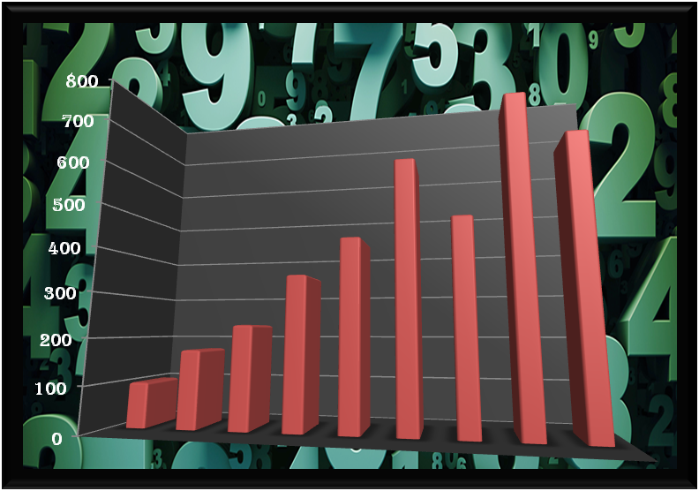
KISS

Slide 29
KISS
KISS = Keep It Simple, Stupid !
Design and information presentation principle
Maximize data-ink ratio
See Visual Display of Quantitative Data, by Tufte (2001)
Use psychological biases to your advantage
Less noise  Less efforts  More at ease  More convincing
Example: “the average distance to the moon is 240,000 miles”

Slide 30

When all you have is a hammer…

Slide 31
When all you have is a hammer…
It doesn’t matter how […] a method is
Elaborate
Elegant
Impressive
Hard to learn
Etc.
If it’s just not what you need, don’t use it
Start with the business question first, then use the simplest method available to answer that question
And sometimes, the simpler method to answer correctly/optimally the question will be very complex
Rely heavily on “model free” evidence if you can

Slide 32
That’s all folks !

